Slide 1
From Euclid to Hilbert, and to Lean
Tianchen Zhao

Slide 2
Euclid’s postulates
To draw a straight line from any point to any point
To extend a finite straight line continuously in a straight line
To describe a circle with any centre and radius
That all right angles are equal to one another
Parallel postulate*
Equality is transitive
Addition property of equality
Subtraction property of equality
Equality is reflexive
The whole is greater than the part
Uniqueness?
Too abstract, philosophical

Slide 3
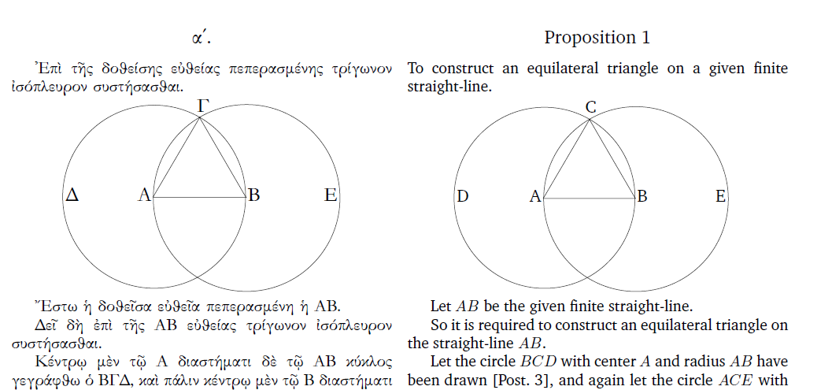
Euclid’s postulates
Don’t know if two circles intersect

Slide 4
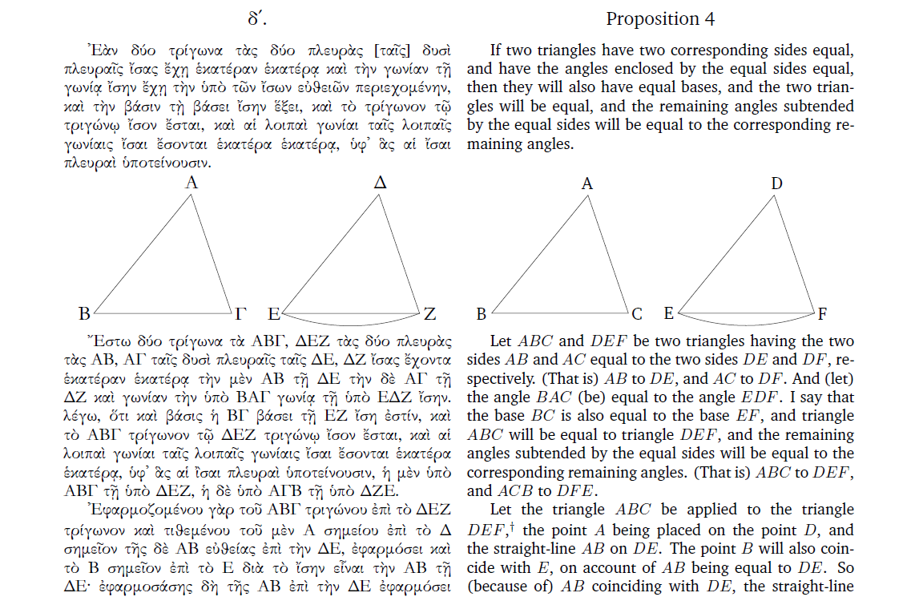
Euclid’s postulates
Assume the existence of rigid motions

Slide 5
Hilbert : Axioms of Incidence
Points
Lines, a set of subset of points
We impose the following axioms on them.
I1. There exists uniquely a line containing two given distinct points.
I2. Every line contains at least two distinct points.
I3. There exists three noncollinear points.

Slide 6
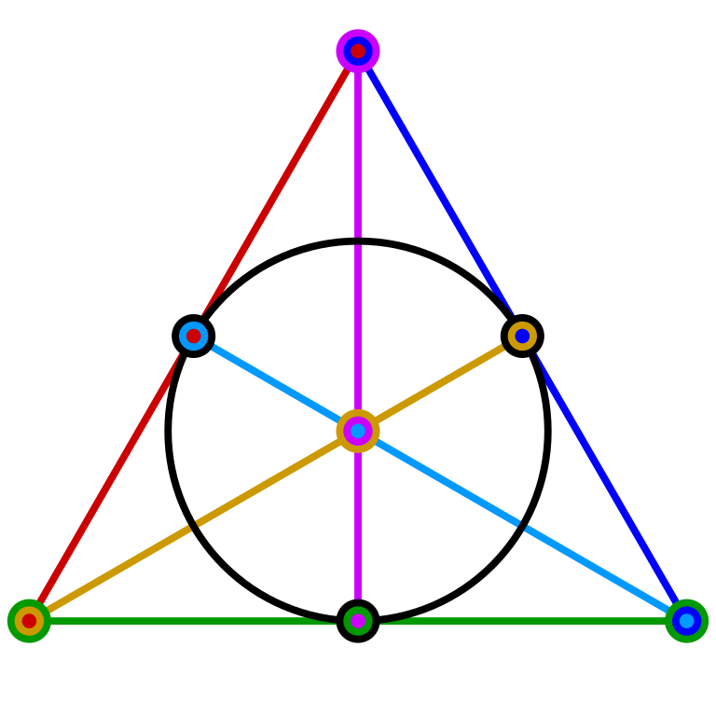
Axioms of Incidence: Fano plane
I1. There exists uniquely a line containing two given distinct points.
I2. Every line contains at least two distinct points.
I3. There exists three noncollinear points.
Consider beyond coordinates and think of this just as an algebraic definition like a group

Slide 7
Parallelism
Two distinct lines intersect in at most one point.
Parallel postulate?
Playfair axiom:
Given a point and a line, there exists at most one line containing the point parallel to it.
We will choose whether to include Playfair axiom or not.
In fact, many propositions are true without it.

Slide 8

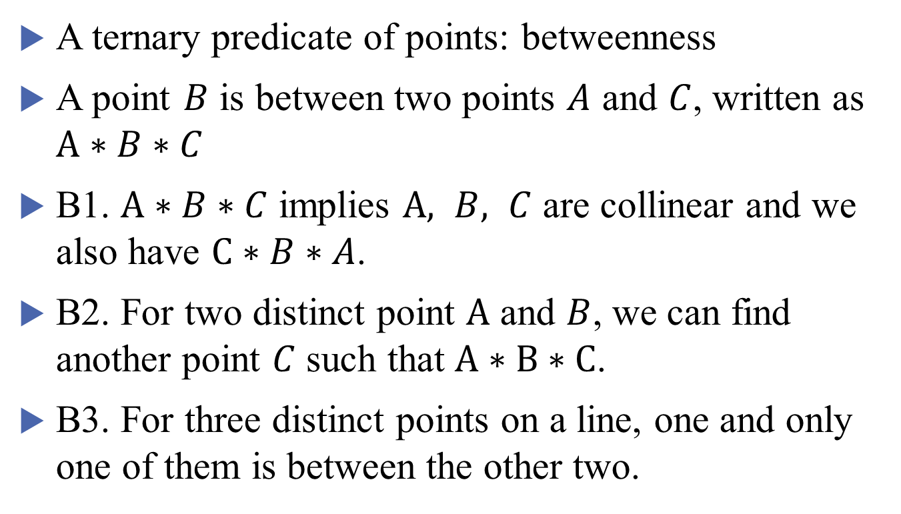


Axioms of Betweenness
$$A$$
$$B$$
$$C$$
A ternary predicate of points: betweenness
A point $B$ is between two points $A$ and $C$, written as $A∗B∗C$
B1. $A∗B∗C$ implies $A, B, C$ are collinear and we also have $C∗B∗A$.
B2. For two distinct point $A$ and $B$, we can find another point $C$ such that $A∗B∗C$.
B3. For three distinct points on a line, one and only one of them is between the other two.

Slide 9

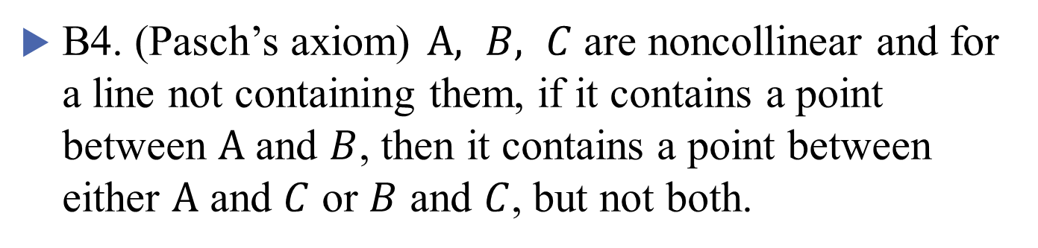





Axioms of Betweenness
B4. (Pasch’s axiom) $A, B, C$ are noncollinear and for a line not containing them, if it contains a point between $A$ and $B$, then it contains a point between either $A$ and $C$ or $B$ and $C$, but not both.
$$A$$
$$A$$
$$C$$
$$C$$
$$B$$
$$B$$

Slide 10

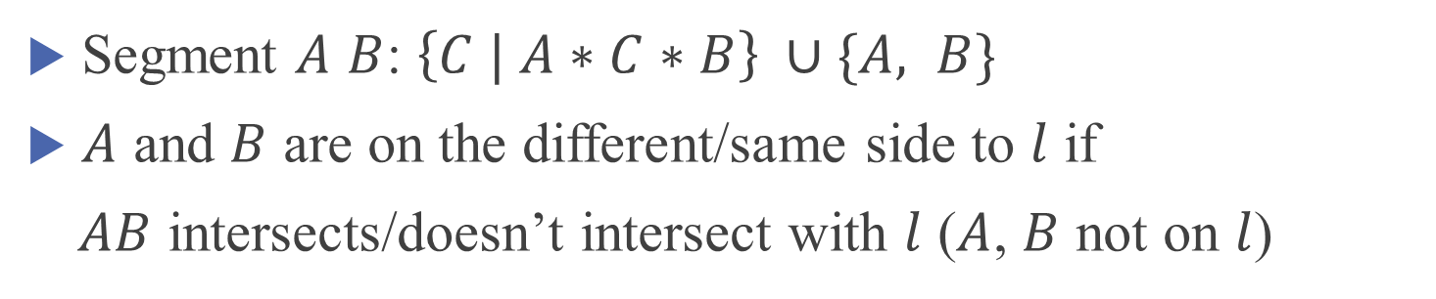



Segments and sidedness
Segment $A$ $B$: $\left\{C | A∗C∗B\right\} ∪\{A, B\}$
$A$ and $B$ are on the different/same side to $l$ if
$AB$ intersects/doesn’t intersect with $l$ ($A$, $B$ not on $l$)
$$A$$
$$A$$
$$B$$
$$B$$

Slide 11



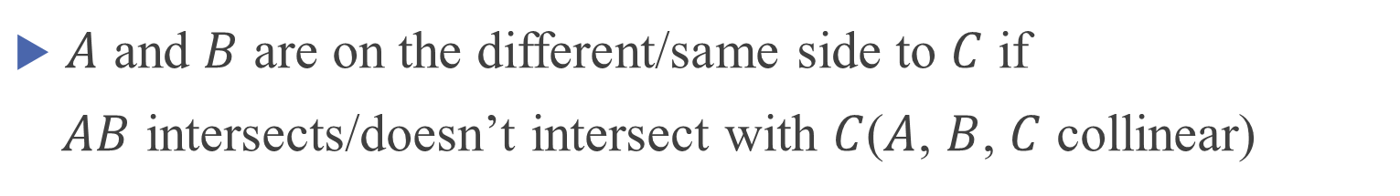



Segments and sidedness
$A$ and $B$ are on the different/same side to $C$ if
$AB$ intersects/doesn’t intersect with $C$($A$, $B$, $C$ collinear)
$$A$$
$$C$$
$$B$$
$$A$$
$$B$$
$$C$$

Slide 12



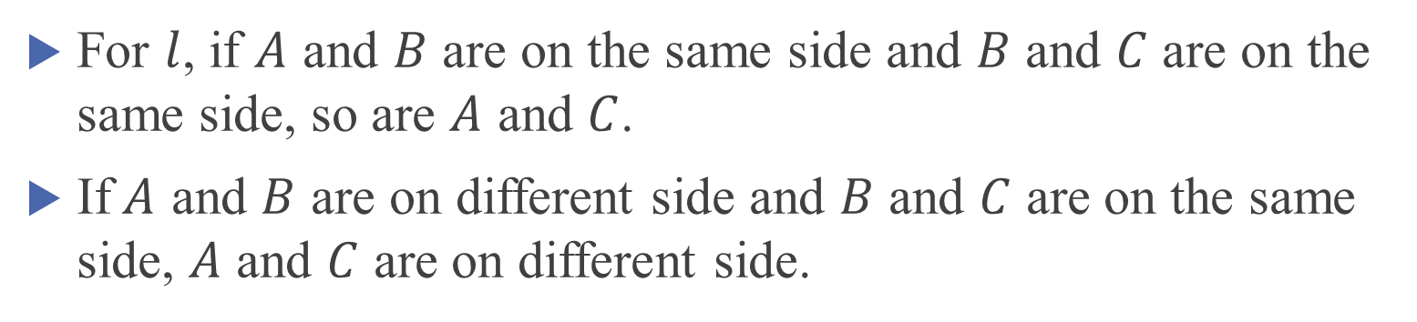



Plane separation theorem
For $l$, if $A$ and $B$ are on the same side and $B$ and $C$ are on the same side, so are $A$ and $C$.
If$A$ and $B$ are on different side and $B$ and $C$ are on the same side, $A$ and $C$ are on different side.
$$A$$
$$A$$
$$C$$
$$B$$
$$B$$
$$C$$
Equivalence to Pasch’s axiom

Slide 13



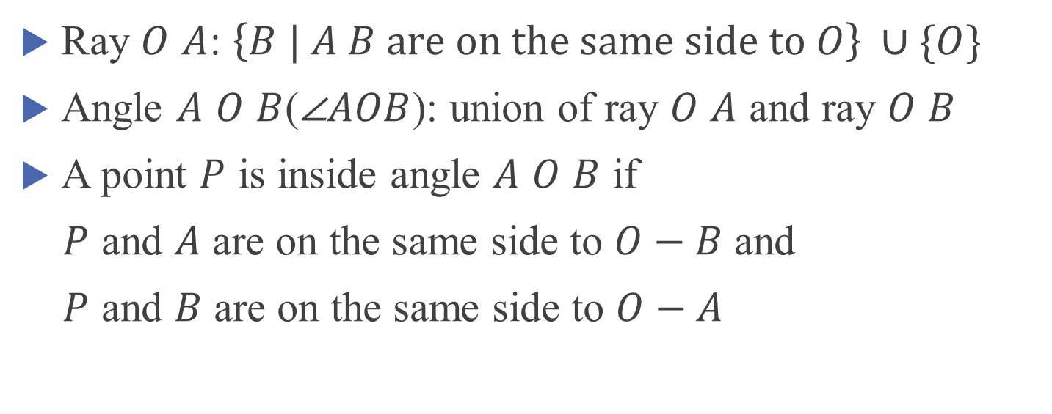



Rays and angles
Ray $O$ $A$: $\left\{B | A B are on the same side to O\right\} ∪\{O\}$
Angle $A$ $O$ $B$($\text{∠}AOB$): union of ray $O$ $A$ and ray $O$ $B$
A point $P$ is inside angle $A$ $O$ $B$ if
$P$ and $A$ are on the same side to $O−B$ and
$P$ and $B$ are on the same side to $O−A$
$$A$$
$$O$$
$$A$$
$$P$$
$$O$$
$$B$$

Slide 14
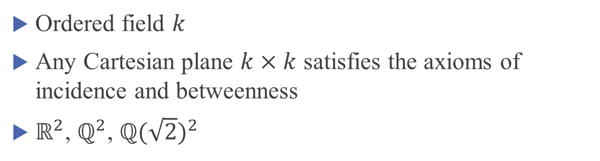
Axioms of Betweenness: examples
Ordered field $k$
Any Cartesian plane $k×k$ satisfies the axioms of incidence and betweenness
$ℝ^{2}$, $ℚ^{2}$, ${ℚ(\sqrt{2})}^{2}$

Slide 15


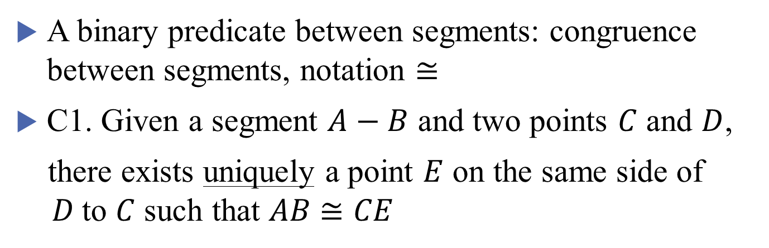



Axioms of Congruence
A binary predicate between segments: congruence between segments, notation $≅$
C1. Given a segment $A−B$ and two points $C$ and $D$,
there exists uniquely a point $E$ on the same side of $D$to $C$ such that $AB$ $≅CE$
$$A$$
$$B$$
$$C$$
$$D$$
$$E$$

Slide 16



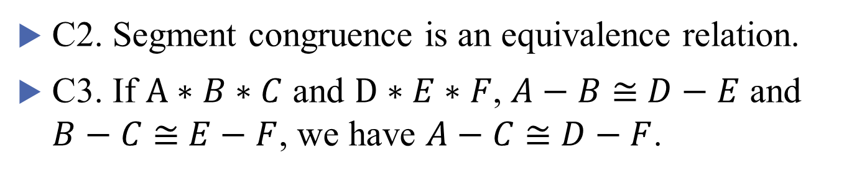



Axioms of Congruence
C2. Segment congruence is an equivalence relation.
C3. If $A∗B∗C$ and $D∗E∗F$, $A−B$ $≅$ $D−E$ and $B−C$ $≅$ $E−F$, we have $A−C$ $≅$ $D−F$.
$$A$$
$$B$$
$$C$$
$$D$$
$$E$$
$$F$$

Slide 17



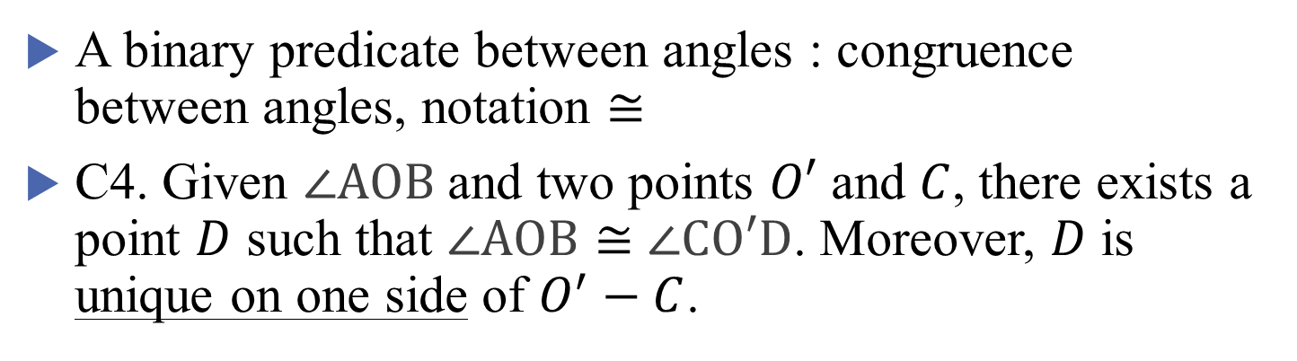



Axioms of Congruence
A binary predicate between angles : congruence between angles, notation $≅$
C4. Given $\text{∠}AOB$and two points $O′$ and $C$, there exists a point $D$ such that $\text{∠}AOB≅$ $\text{∠}\text{CO}′\text{D}$. Moreover, $D$ is unique on one side of $O^{′}−C$.
$$A$$
$$D$$
$$O$$
$$B$$
$$O′$$
$$C$$

Slide 18





Axioms of Congruence
C5. Angle congruence is an equivalence relation.
C6. SAS congruence!!!
$$A$$
$$D$$
$$C$$
$$B$$
$$F$$
$$E$$

Slide 19
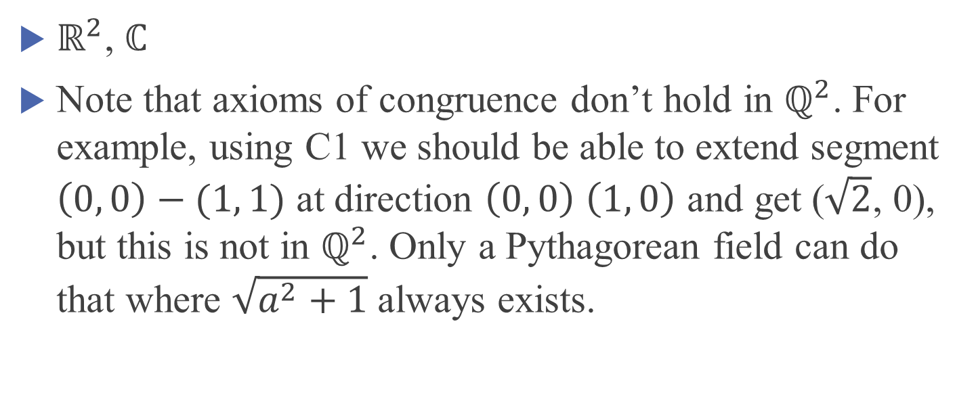
Axioms of Congruence: examples
$ℝ^{2}$, $ℂ$
Note that axioms of congruence don’t hold in $ℚ^{2}$. For example, using C1 we should be able to extend segment $\left(0, 0\right)−(1, 1)$ at direction $\left(0, 0\right)$ $\left(1, 0\right)$ and get ($\sqrt{2}$, 0), but this is not in $ℚ^{2}$. Only a Pythagorean field can do that where $\sqrt{a^{2}+1}$ always exists.

Slide 20
Axioms of Congruence
Using axioms of incidence, betweenness and congruence, we are able to prove most statements not involving circles.
We will go through them later in Lean.

Slide 21


Geometry in Lean
What’s the difference?
Segment as a set vs as a type

Slide 22
Geometry in Lean
Defining segment as a type will be easier to implement when we introduce segment congruence.

Slide 23

Geometry in Lean
What’s the difference?
In the first case, segment is not symmetric!

Slide 24
Geometry in Lean
Need to very careful on betweenness, sidedness etc.
Draw it, but think beyond your drawing
Very obvious relations on the drawing may be hard to prove.

Slide 25


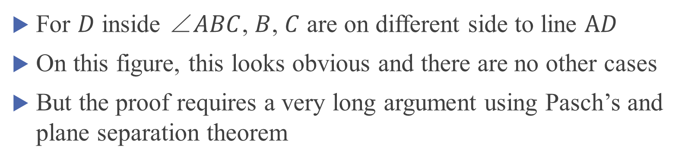


Geometry in Lean: crossbar theorem
For $D$ inside $\text{∠}ABC$, $B$, $C$ are on different side to line $AD$
On this figure, this looks obvious and there are no other cases
But the proof requires a very long argument using Pasch’s and plane separation theorem
$$B$$
$$D$$
$$A$$
$$C$$

Slide 26
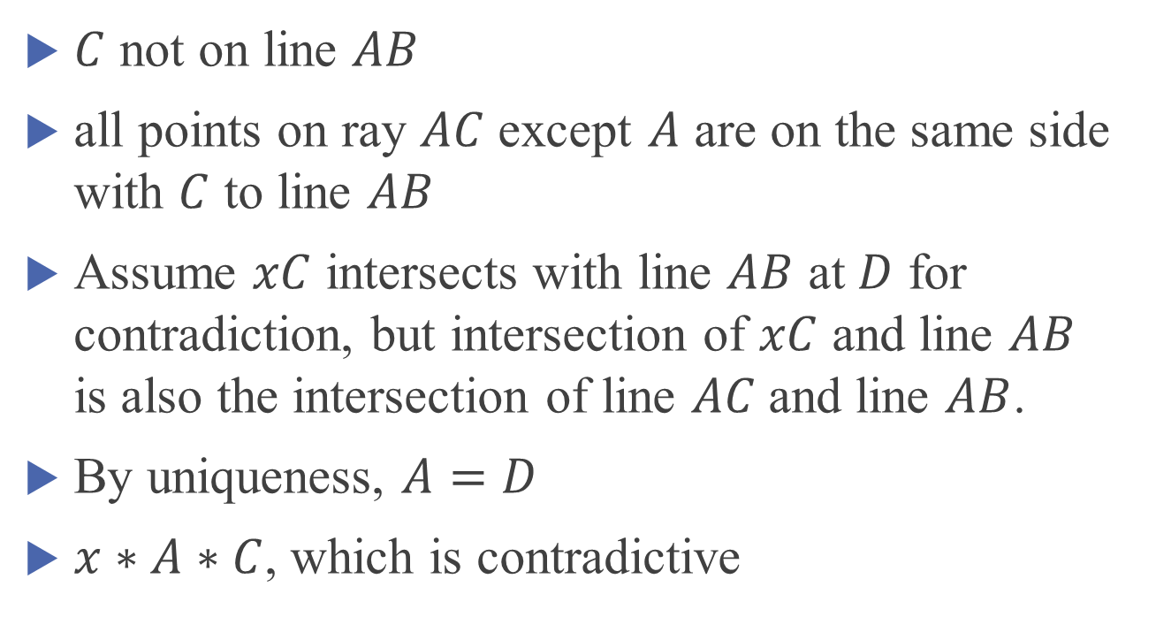




Geometry in Lean: T shape model
$C$ not on line $AB$
all points on ray $AC$ except $A$ are on the same side with $C$ to line $AB$
Assume $xC$ intersects with line $AB$ at $D$ for contradiction, but intersection of $xC$ and line $AB$ is also the intersection of line $AC$and line $AB$.
By uniqueness, $A=D$
$x∗A∗C$, which is contradictive
$$C$$
$$x$$
$$A$$
$$B$$

Slide 27



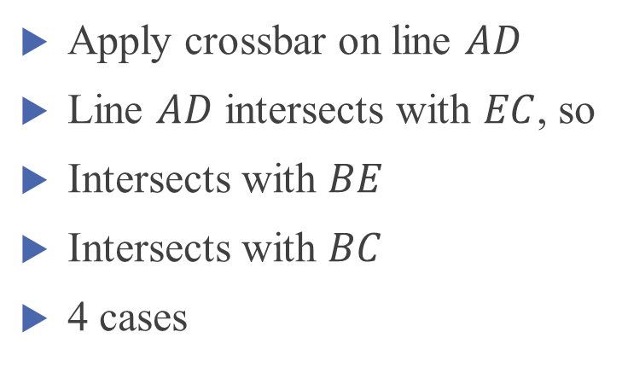


Geometry in Lean: crossbar theorem
Apply crossbar on line $AD$
Line $AD$ intersects with $EC$, so
Intersects with $BE$
Intersects with $BC$
4 cases
$$B$$
$$D$$
$$E$$
$$A$$
$$C$$

Slide 28

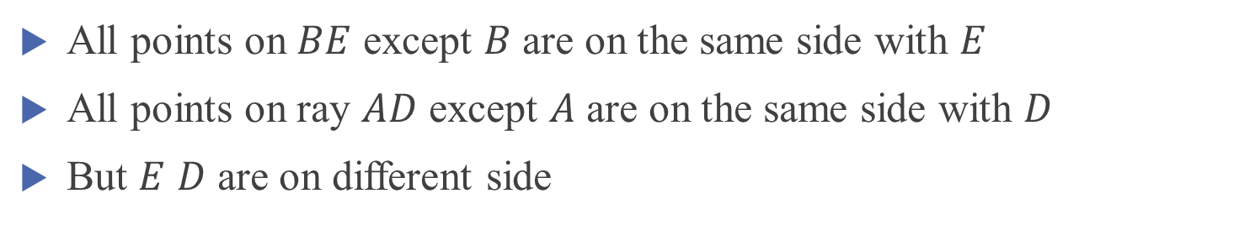

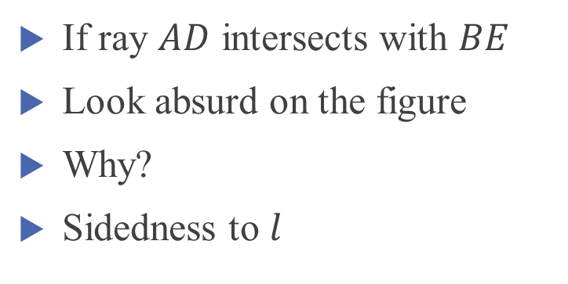




Geometry in Lean: crossbar theorem
$$l$$
If ray $AD$ intersects with $BE$
Look absurd on the figure
Why?
Sidedness to $l$
$$B$$
$$E$$
$$D$$
$$A$$
$$C$$
All points on $BE$ except $B$ are on the same side with $E$
All points on ray $AD$ except $A$ are on the same side with $D$
But $E$ $D$ are on different side

Slide 29




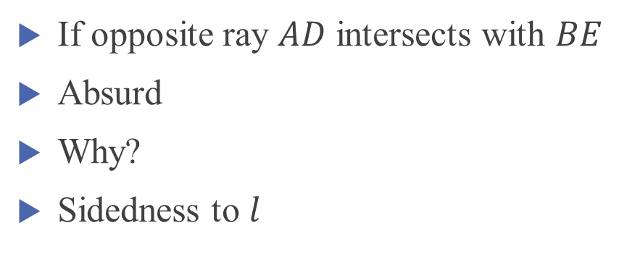


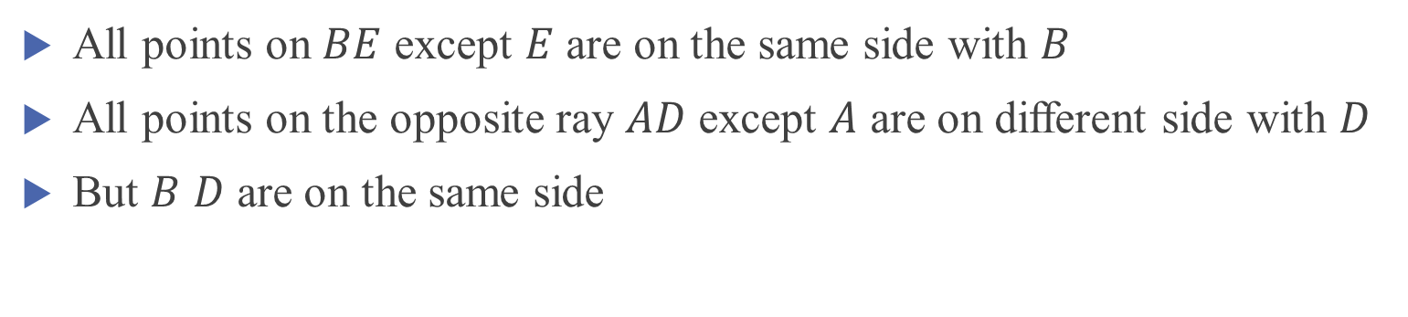
Geometry in Lean: crossbar theorem
$$B$$
If opposite ray $AD$ intersects with $BE$
Absurd
Why?
Sidedness to $l$
$$E$$
$$D$$
$$A$$
$$l$$
$$C$$
All points on $BE$ except $E$ are on the same side with $B$
All points on the opposite ray $AD$ except $A$ are on different side with $D$
But $B$ $D$ are on the same side

Slide 30




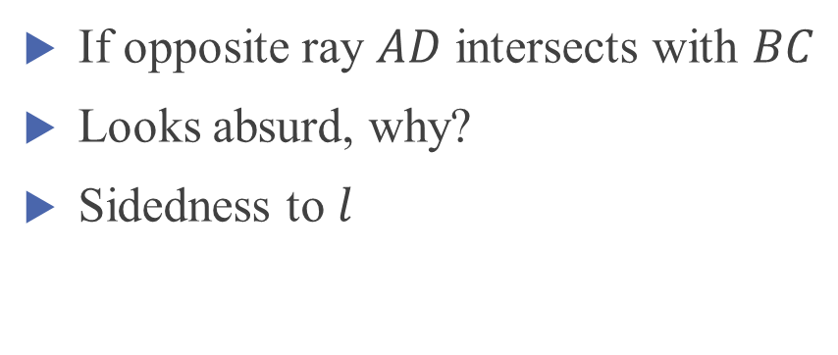


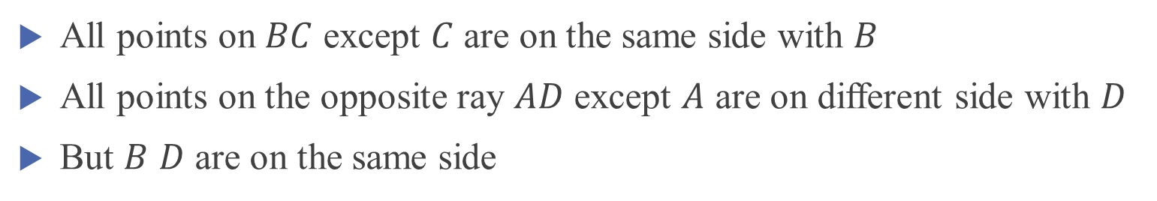
Geometry in Lean: crossbar theorem
$$B$$
If opposite ray $AD$ intersects with $BC$
Looks absurd, why?
Sidedness to $l$
$$D$$
$$E$$
$$A$$
$$l$$
$$C$$
All points on $BC$ except $C$ are on the same side with $B$
All points on the opposite ray $AD$ except $A$ are on different side with $D$
But $B$ $D$ are on the same side

Slide 31


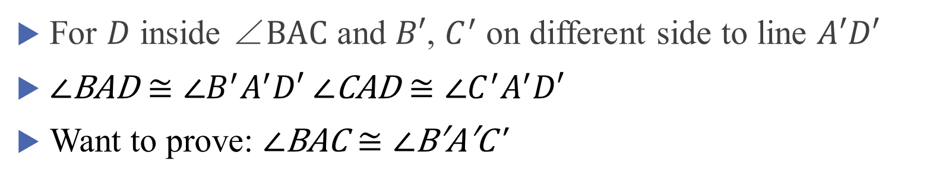




Geometry in Lean: angle addition theorem
For $D$ inside $\text{∠}BAC$ and $B′$, $C^{′}$ on different side to line $A′D′$
$\text{∠}\text{BAD}≅\text{∠}B^{′}A^{′}D′$ $\text{∠}\text{CAD}≅\text{∠}C^{′}A^{′}D′$
Want to prove: $\text{∠}\text{BAC}≅\text{∠}\text{B}\text{′}\text{A}\text{′}\text{C}\text{′}$
$$B′$$
$$B$$
$$D′$$
$$D$$
$$A$$
$$C$$
$$A′$$
$$C′$$
Proof by SAS and
supplementary of congruence angles are congruent

Slide 32




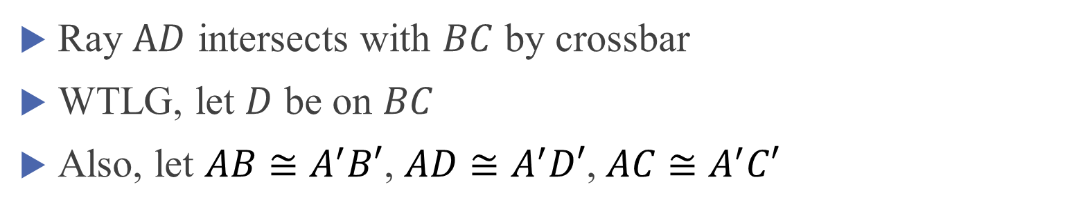





Geometry in Lean: angle addition theorem
Ray $AD$ intersects with $BC$ by crossbar
WTLG, let $D$ be on $BC$
Also, let $AB$ $≅A^{′}B′$, $AD$ $≅A^{′}D′$, $AC$ $≅A^{′}C′$
$$B$$
$$B′$$
$$B′$$
$$D$$
$$D′$$
$$D′$$
$$A$$
$$C$$
$$A′$$
$$C′$$
$$C′$$

Slide 33




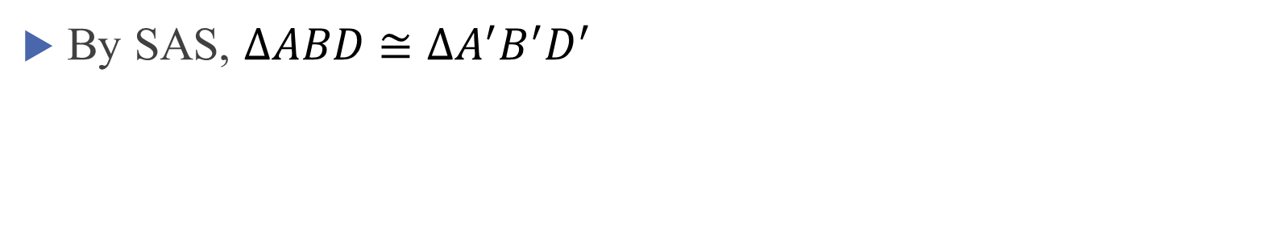


Geometry in Lean: angle addition theorem
By SAS, $∆ABD$ $≅{∆A}^{′}B^{′}D^{′}$
$$B$$
$$B′$$
$$D′$$
$$D$$
$$A$$
$$C$$
$$A′$$
$$C′$$

Slide 34
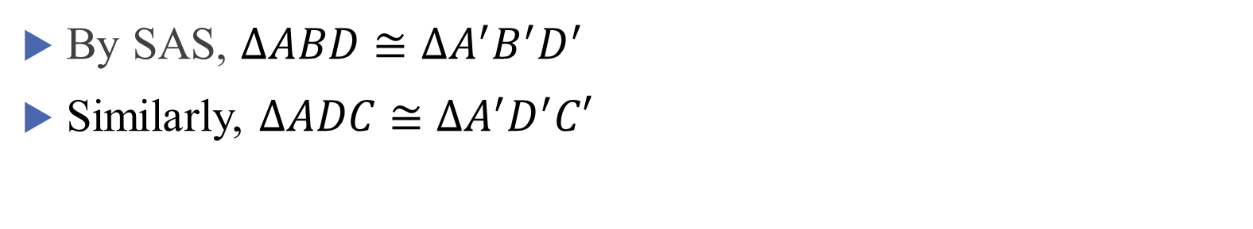
Geometry in Lean: angle addition theorem
By SAS, $∆ABD$ $≅{∆A}^{′}B^{′}D^{′}$
Similarly, $∆ADC$ $≅{∆A}^{′}D^{′}C′$
$$B$$
$$B′$$
$$D′$$
$$D$$
$$A$$
$$C$$
$$A′$$
$$C′$$

Slide 35




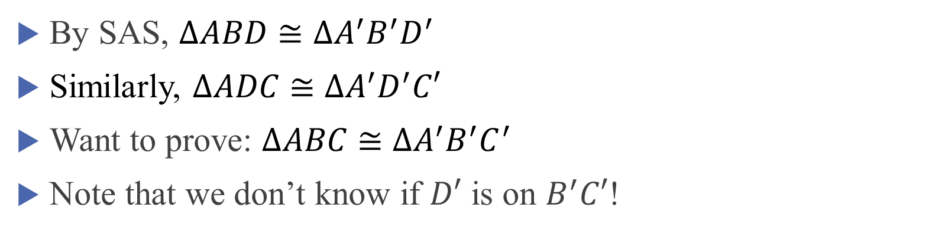


Geometry in Lean: angle addition theorem
By SAS, $∆ABD$ $≅{∆A}^{′}B^{′}D^{′}$
Similarly, $∆ADC$ $≅{∆A}^{′}D^{′}C′$
Want to prove: $∆ABC$ $≅{∆A}^{′}B^{′}C^{′}$
Note that we don’t know if $D′$ is on $B^{′}C′$!
$$B$$
$$B′$$
$$D′$$
$$D$$
$$A$$
$$C$$
$$A′$$
$$C′$$

Slide 36

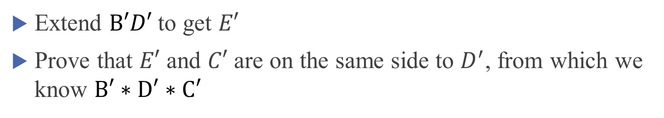
Geometry in Lean: angle addition theorem
Extend $B′D′$ to get $E′$
Prove that $E′$ and $C′$ are on the same side to $D^{′}$, from which we know $B′∗D′∗C′$
$$B$$
$$B′$$
$$D′$$
$$D$$
$$E′$$
$$A$$
$$C$$
$$A′$$
$$C′$$

Slide 37





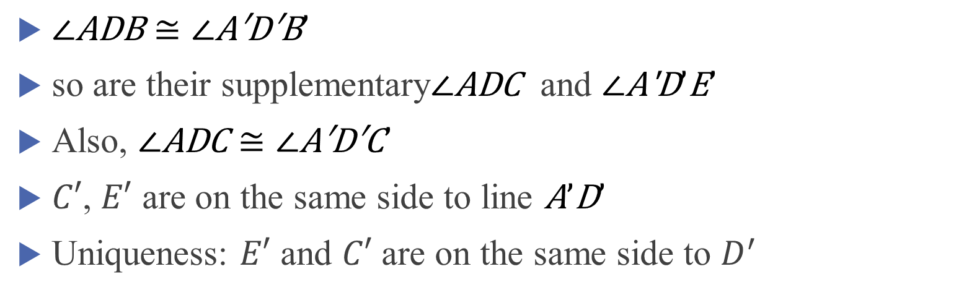


$\text{∠}\text{ADB}≅\text{∠}\text{A}\text{′}\text{D}\text{′}\text{B}’$
so are their supplementary$\text{∠}\text{ADC}$ and $\text{∠}\text{A}\text{′}\text{D}’\text{E}’$
Also, $\text{∠}\text{ADC}≅\text{∠}\text{A}\text{′}\text{D}\text{′}\text{C}’$
$C′$, $E′$ are on the same side to line $\text{A}’\text{D}’$
Uniqueness: $E′$ and $C′$ are on the same side to $D^{′}$
$$B$$
$$B′$$
$$D′$$
$$D$$
$$E′$$
$$A$$
$$C$$
$$A′$$
$$C′$$

Slide 38
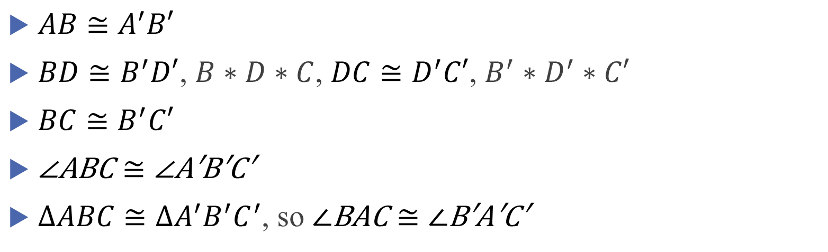

$AB$ $≅A^{′}B′$
$BD$ $≅B^{′}D′$, $B∗D∗C$, $DC$ $≅D^{′}C′$, $B^{′}∗D^{′}∗C′$
$BC$ $≅B^{′}C′$
$\text{∠}\text{ABC}≅\text{∠}\text{A}\text{′}\text{B}\text{′}\text{C}\text{′}$
$∆ABC$ $≅{∆A}^{′}B^{′}C^{′}$, so $\text{∠}\text{BAC}≅\text{∠}\text{B}\text{′}\text{A}\text{′}\text{C}\text{′}$
$$B$$
$$B′$$
$$D′$$
$$D$$
$$A$$
$$C$$
$$A′$$
$$C′$$

Slide 39
What’s already done
SAS, SSS, ASA, AAS, HL(right-angle-hypotenuse-side)
Existence of isosceles triangle, angular bisector, midpoint
Most propositions in Elements book I not involving circles

Slide 40
What to do next
Segment arithmetic, angle arithmetic
Take quotient class using equivalence relation of congruence
Axioms on intersection of circles and lines
GCSE circle theorems, ruler and compass construction
More axioms of incidence
Non-Euclidean geometry
Existence of rigid motions is equivalent to SAS
Competition stuffs?
Area…

Slide 41
Some advice
Don’t be afraid to read new stuffs
Ask on Zulip or discord
Write your own codes
Euclid and Beyond by Hartshorne
Theorem Proving in Lean

